Slide 2

Basho Technologies
Decisions, Decisions, Decisions

Slide 4


2¹⁶⁰
0
2¹⁶⁰/2
Notes:
--

Slide 5

2¹⁶⁰
0
2¹⁶⁰/2
Notes:
--

Slide 6
Replication

Slide 7
Notes:
--

Slide 8
N - Value (n_val = 3)

Slide 10

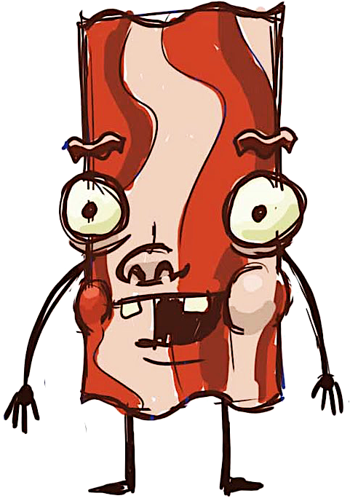
Notes:
--

Slide 11
Notes:
--

Slide 12
oops!
Notes:
--

Slide 13
Notes:
--

Slide 14
i hope they get it right!
Notes:
--

Slide 15
Notes:
--

Slide 16
what did I get for Casey?
Notes:
--

Slide 17
what the
???
Notes:
--

Slide 19
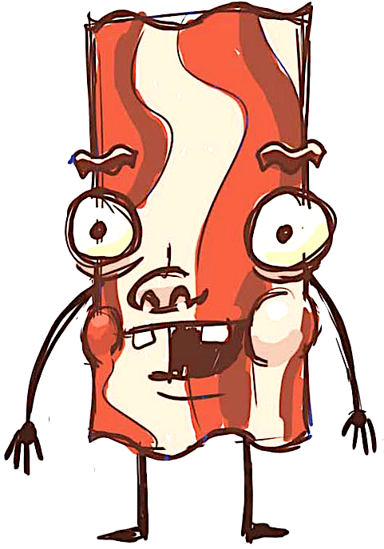
what did I get for Casey?
Notes:
-- vclocks / LWW

Slide 20
Read-Repair

Slide 22

making a list
checking it twice
Notes:
--

Slide 23
what did I get for Casey?
Notes:
--

Slide 24
Active Anti-Entropy

Slide 26
Notes:
--

Slide 27
Notes:
--

Slide 28
what did I get for Casey?
Notes:
--

Slide 29
???
Notes:
--

Slide 30
Siblings

Slide 32
Notes:
--

Slide 33
yep!
are you done yet?
yep!
yep!
Notes:
--

Slide 34
yep!
are you done yet?
yep!
meh, good enough.
zzz…
Notes:
--

Slide 35
Quorum

Slide 36
R

Slide 37
W, DW

Slide 38
PR, PW

Slide 39
Notes:
--

Slide 40
Notes:
--

Slide 41

here
right this
way sir
Notes:
--

Slide 42
here
right this
way sir
hang here
for a bit.
Notes:
--

Slide 43
here
right this
way sir
not gonna happen!
Notes:
--

Slide 44
Notes:
- replication, read repair, siblings, quorums

Slide 45
Decisions, Decisions, Decisions
Notes:
- replication, read repair, siblings, quorums

